Slide 1


VARDHAMAN COLLEGE OF ENGINEERING, HYDERABAD
Autonomous institute affiliated to JNTUH
DEPARTMENT OF CSE(AI&ML)
III-Year Mini Project Abstract Level Review
Title: Sales Forecast Prediction
Domain: Machine Learning
BATCH ID : 40
S. No | Roll. No | Student Name
1 | 23881A6669 | B Sai Abhighn Reddy
2 | 23881A66A1 | P Venkata Teja
3 | 23881A66A7 | R Vijitha
4 | 24885A6614 | S Aishwarya
Supervisor
Ms. D Sandhya Rani
Assistant Professor
Department of CSM

Slide 2
Outlines
Abstract
Introduction
Literature Review
Existing System with Pros and Cons (comparison with existing systems- Table)
Objectives & Expected Deliverables
SDG Mapping
PO Mapping
PSO Mapping
Timeline
References

Slide 3
Abstract
Sales forecast prediction is a crucial aspect of modern business strategy, enabling organizations to anticipate future revenue and make informed operational decisions.
This project focuses on leveraging historical sales data and advanced predictive techniques to estimate future sales performance.
By applying machine learning models, the system identifies patterns and trends that traditional methods might overlook.
The objective is to improve forecasting accuracy, reduce uncertainty, and assist businesses in optimizing inventory management, marketing efforts, and financial planning.

Slide 4
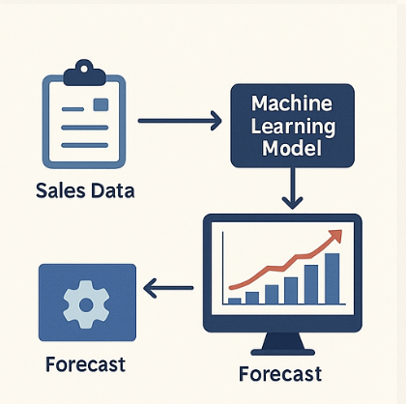
Introduction
Sales forecast prediction is the process of estimating future sales based on historical data, trends, and influencing factors.
It helps businesses plan inventory, budget effectively, set realistic sales goals, and make data-driven decisions.
Accurate sales forecasting ensures companies can meet customer demand without overproducing or understocking.
Sales forecasting uses data such as past sales, market trends, seasonality, promotions, and customer behavior.
Traditional forecasting methods often struggle with complex data patterns and changing market dynamics.

Slide 5
Existing System
Traditional Statistical Methods - Models like Linear Regression, Moving Average, and ARIMA are used for basic forecasting using historical sales data.
Spreadsheet Tools - Microsoft Excel and Google Sheets are commonly used for manual forecasting with formulas, charts, and trendlines.
ERP/CRM Systems - Platforms like Salesforce, SAP, Oracle NetSuite, and Microsoft Dynamics 365 offer built-in forecasting features integrated with customer and sales data.
Business Intelligence (BI) Tools - Tools like Tableau, Power BI, and QlikView support sales forecasting through data visualization and predictive analytics.
Custom Machine Learning Solutions - Built using Python, libraries like Scikit-learn, XGBoost, LSTM (TensorFlow/Keras), and Facebook Prophet enable tailored, high-accuracy forecasting models.

Slide 6
Pros and Cons of Existing System
Pros:
Sales forecasting systems improve accuracy by identifying complex trends using machine learning and statistical models.
Cloud-based platforms offer scalability, allowing businesses to handle large volumes of sales data efficiently.
They automate the forecasting process, saving time and minimizing human errors.
Cons:
The accuracy of forecasts depends heavily on the availability and quality of historical sales data.
Advanced forecasting tools can be expensive to implement and maintain, especially for small businesses.
Using cloud-based tools raises concerns about data privacy and security.

Slide 7
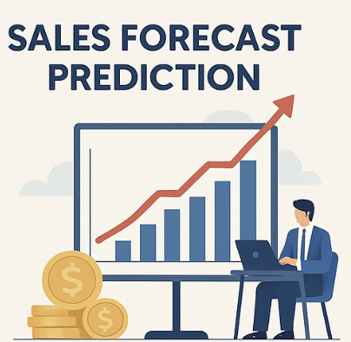
Problem Statement
Sales forecasting is a crucial function for businesses to plan inventory, allocate resources, and set revenue goals effectively.
Traditional forecasting methods struggle to adapt to dynamic market trends, seasonal variations, and irregular customer behavior.
Machine learning techniques offer improved accuracy by learning complex relationships in data that traditional models often miss.
This project aims to implement and evaluate ML-based models to provide reliable, data-driven sales forecasts for better business decision-making.

Slide 8
Objectives & Deliverables Proposed System
Objectives:
To develop a machine learning model that accurately forecasts future sales using historical data.
To automate the sales prediction process for better inventory, budgeting, and marketing decisions.
To evaluate and compare different forecasting models to identify the most effective one.
Expected Deliverables:
A trained and tested machine learning model capable of predicting future sales.
A visualization dashboard or report to display forecast results and insights.
Comparative analysis of different models with accuracy scores.

Slide 9



SDG Mapping
SDG Goal | Goal Title | Justification
 | Decent Work and Economic Growth | Improves business efficiency and stability through accurate demand planning, supporting economic growth.
 | Industry, Innovation and Infrastructure | Applies AI and machine learning for smart forecasting, promoting innovation and digital transformation.
 | Responsible Consumption & Production | Reduces overproduction and waste by aligning inventory and resources with actual sales demand.

Slide 10
PO Mapping
PO Number | PO Description | Justification
PO1 | Engineering Knowledge | Builds a strong foundation in math, statistics, and ML needed for accurate sales forecasting.
PO3 | Design/Development of Solutions | Applies optimized machine learning models to solve real-world business problems.
PO5 | Engineering Tool Usage | Uses modern tools and techniques for prediction and modeling to tackle complex challenges.

Slide 11

PSO Mapping
PSO Number | PSO Description | Justification
PSO1 | Apply AI knowledge to design and evaluate intelligent solutions | Applied to communication problems in business, education, and customer support.
PSO2 | Use advanced ML tools and techniques for intelligent decision-making | Employed Scikit-learn, Transformers, and Streamlit to build and evaluate models.

Slide 12
Timelines
Month | Activities
June 2025 | Requirement Analysis, Literature Review
July 2025 | Dataset Collection, Preprocessing, Classifier & Response Model Development
August 2025 | Frontend and Backend Integration using Streamlit & Flask
September 2025 | Unit Testing, Final Deployment, Documentation and Report Submission

Slide 13
References
[1] H. A. Omar and D.-R. Liu, “Enhancing sales forecasting by using neuro networks and the popularity of magazine article titles,” in Proc. Int. Conf. Genet. Evol. Comput., 2012, pp. 577–580.
[2] B. M. Pavlyshenko, “Machine-learning models for sales time series forecasting,” Data, vol. 4, no. 1, pp. 1–15, Jan. 2019.
[3] C.-J. Lu and L.-J. Kao, “A clustering-based sales forecasting scheme by using extreme learning machine and ensembling linkage methods with applications to computer server,” Eng. Appl. Artif. Intell., vol. 55, pp. 231–238, Oct. 2016.
[4] C. C. Holt, “Forecasting seasonals and trends by exponentially weighted moving averages,” Int. J. Forecast., vol. 20, no. 1, pp. 5–10, Jan. 2004.
[5] R. H. Shumway and D. S. Stoffer, “ARIMA models,” in Time Series Analysis and Its Applications, 4th ed. New York, NY, USA: Springer, 2017, pp. 75–133.

Slide 14
THANK YOU

